Slide 1
Implementing Anomaly Detection Algorithms for Network Intrusion Detection

Slide 2
2300080257- S.Sai Kiran 2300080283-V Surya Theja 2300080329-Sai Priyanka

Slide 3
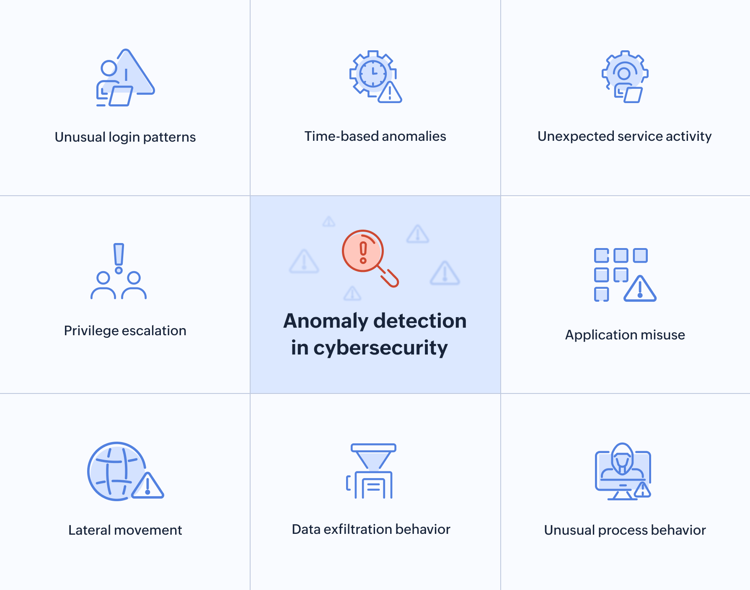
lntroduction: Why Anomaly Detection Matters in Network Security
Network Intrusion Detection Systems (NIDS) monitor traffic to detect malicious activity and protect critical infrastructure from sophisticated cyber threats.
Unlike signature-based IDS that rely on known attack patterns, anomaly detection identifies unknown or zero-day attacks by spotting deviations from normal behaviour patterns.
Growing cyber threats and increasingly complex network environments demand advanced anomaly detection techniques to safeguard sensitive data and maintain operational continuity.

Slide 4
Scenario: Detecting Unknown Threats in Dynamic Networks
Modern Threat Landscape
Baseline Establishment
Networks face evolving threats including zero-day exploits, insider attacks, and sophisticated malware campaigns targeting critical infrastructure.
Anomaly detection models establish comprehensive baselines of normal network traffic patterns and flag unusual deviations that may indicate security breaches.
Practical Example
Sudden spikes in traffic volume, unusual protocol usage, or abnormal connection patterns may indicate a breach attempt or reconnaissance activity.

Slide 5
Literature Survey:
Past algorithms, such as Signature-Based IDS, relied on a database of known threats, making them completely ineffective against new "zero-day" attacks that had no existing record. Later Distance-Based (k-NN) and Density-Based (LOF) algorithms were introduced, but they struggled with high-dimensional network data, often becoming computationally too slow for real-time traffic. These traditional methods also required massive amounts of "normal" data to build a baseline profile, which was easily distorted by noise or slight shifts in user behavior.
Isolation Forest overcomes these challenges by flipping the logic: instead of trying to define what is "normal," it focuses exclusively on how easy it is to "isolate" a point. Because it uses random partitioning rather than complex distance calculations, it is significantly faster and requires much less memory, making it ideal for high-speed networks. It effectively handles "swamping" (where normal points hide anomalies) and "masking" (where groups of anomalies hide each other) through sub-sampling techniques. This shift from profiling the majority to isolating the minority allows it to detect unknown intrusions with high accuracy and minimal manual tuning.

Slide 6
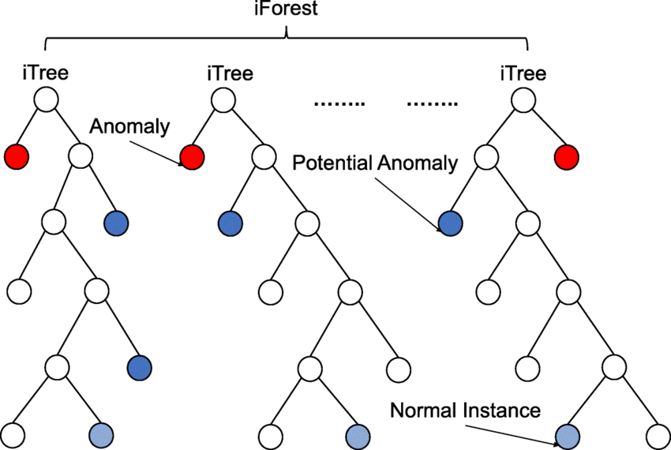
Algorithm Used
Isolation Forest
Random Partitioning: The algorithm builds binary decision trees by recursively selecting a random feature and making a random split within that feature's range to divide the dataset.
Isolation Path: The number of splits required to completely isolate a specific data point is recorded as its "isolation path." Anomalies naturally require fewer splits to be isolated because they are significantly different from the rest of the data.
Ensemble of Trees: Instead of relying on a single tree, the algorithm builds a "forest" of multiple independent trees with diverse random splits, ensuring the model's robustness and reliability.
Anomaly Scoring: Each data point receives an anomaly score based on the average length of its isolation paths across all the trees in the forest. Shorter average paths strongly indicate that the point is an anomaly.
Classification: Finally, a predetermined threshold is applied to the anomaly scores; data points scoring above this threshold are classified as anomalies, while those below are classified as normal network traffic.

Slide 7



Data Preprocessing: Preparing Network Data for Detection
Raw Data Collection
Network data includes packet metadata, connection duration, protocol types, flags, and traffic flow characteristics.
Data Transformation
Normalisation using min-max scaling, feature extraction, and dimensionality reduction to handle high-dimensional network datasets effectively.
Feature Engineering
Hybrid feature engineering techniques including deep feature synthesis enhance meaningful pattern discovery and model performance.

Slide 8
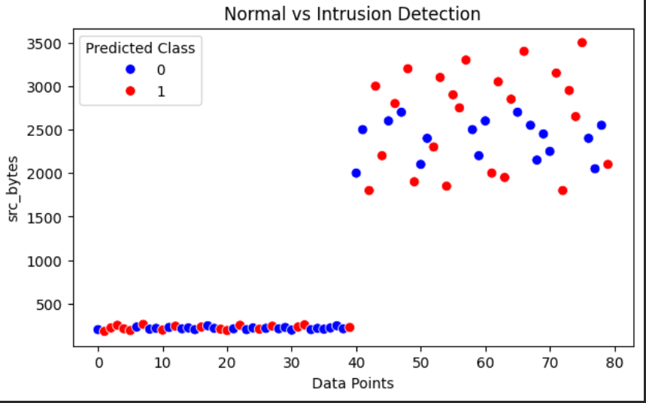
Outcomes: Benefits of Anomaly Detection in IDS
Early Threat Detection
Enhanced Visibility
Rapid identification of novel and unknown attacks, significantly reducing potential breach impact and system compromise.
Improved network visibility and situational awareness, empowering security teams with actionable intelligence.
Adaptive Security
Comprehensive Detection
Reduced reliance on signature databases, enabling dynamic and adaptive security postures against emerging threats.
Enhanced detection of subtle, contextual, and collective anomalies in complex network traffic patterns.

Slide 9
Limitations and Challenges
1
False Positive Rates
High false positive rates due to dynamic network behaviour and noisy data environments requiring continuous model refinement.
2
Dimensionality Issues
Curse of dimensionality where large feature sets can significantly degrade model performance and computational efficiency.
3
Concept Drift
Evolving network patterns require continuous model updates and retraining to maintain detection effectiveness over time.
4
Real-time Constraints
Computational complexity and latency issues in real-time detection environments challenge practical deployment scalability.

Slide 10
Abstract
In the modern digital era, computer networks have become an essential part of every organization, but they are also highly vulnerable to various cyberattacks. Hackers and malicious programs often try to enter networks without permission to steal sensitive data, damage systems, or disrupt normal operations. To protect valuable information and maintain network safety, it is important to detect such attacks as early as possible. This project aims to develop an Intrusion Detection System (IDS) that can automatically identify suspicious or abnormal behavior in network traffic. The system collects and analyzes network data, learns the normal patterns of user activities, and then detects any unusual activities that could be possible intrusions. It uses machine learning techniques such as Isolation Forest or Autoencoder to accurately find these anomalies. Whenever suspicious behavior is detected, the system raises alerts to warn network administrators. By detecting intrusions quickly, this system helps prevent data theft, reduce damage, and improve the overall security of the network. This approach makes it easier for organizations to monitor their networks and respond to cyber threats effectively.

Slide 11
THANK YOU

